Slide 1
PDS
SDN
NFV
Computer Vision
Chapter 2 :
Artificial Neural Network
Feedforward
Backpropagation
https://github.com/siagianp
Notes:
https://www.datacamp.com/blog/what-is-machine-learning

Slide 2
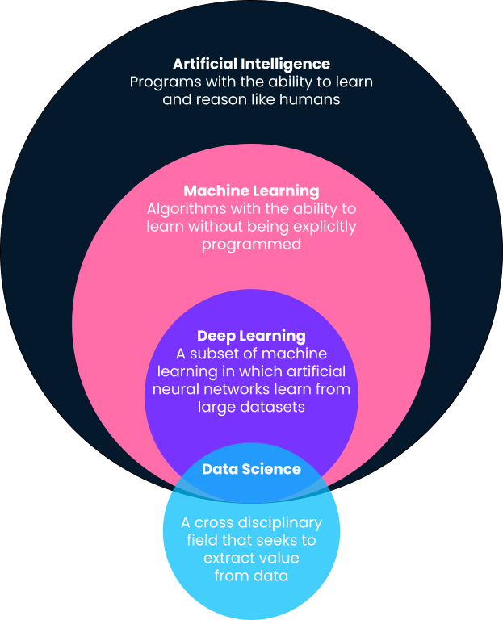
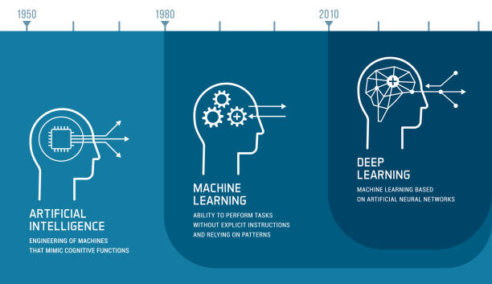
Notes:
https://www.datacamp.com/blog/what-is-machine-learning

Slide 3


Slide 4
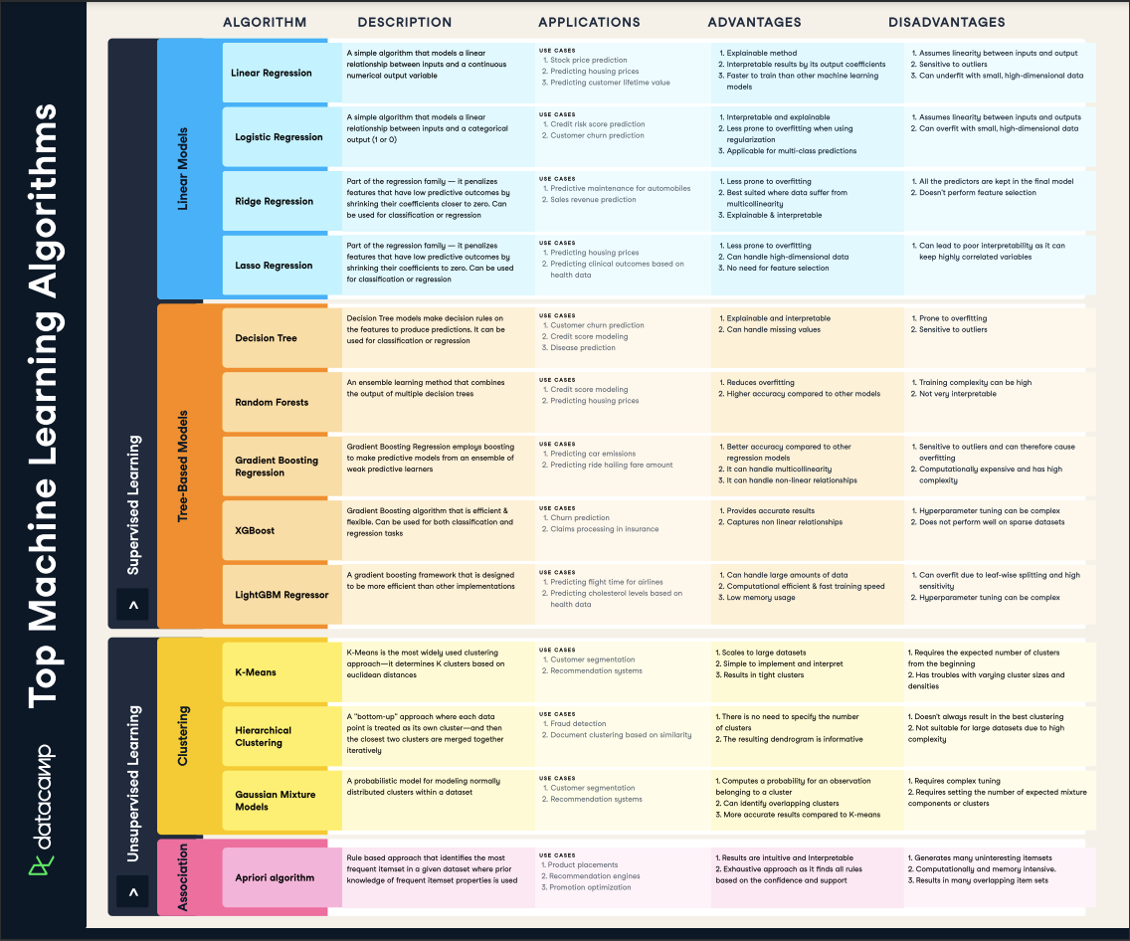

Slide 5
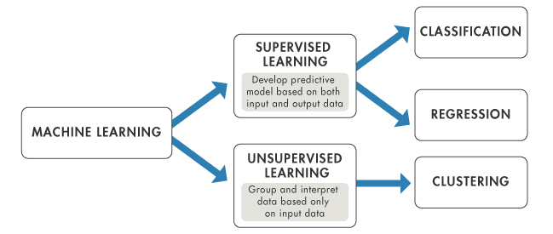

Slide 6
Types of Learning
Supervised Learning
Supervised learning uses a labeled dataset, typically labeled by an external supervisor, subject matter expert(SME), or an algorithm/program. The dataset is split into training and test dataset for training and then validating the model. The supervised learned model is then used to generate predictions on previously unseen unlabeled data that belongs to the category of data the model was trained on.
Input and output data is provided to a Supervised machine model, so supervised learning is learning by example.

Slide 7
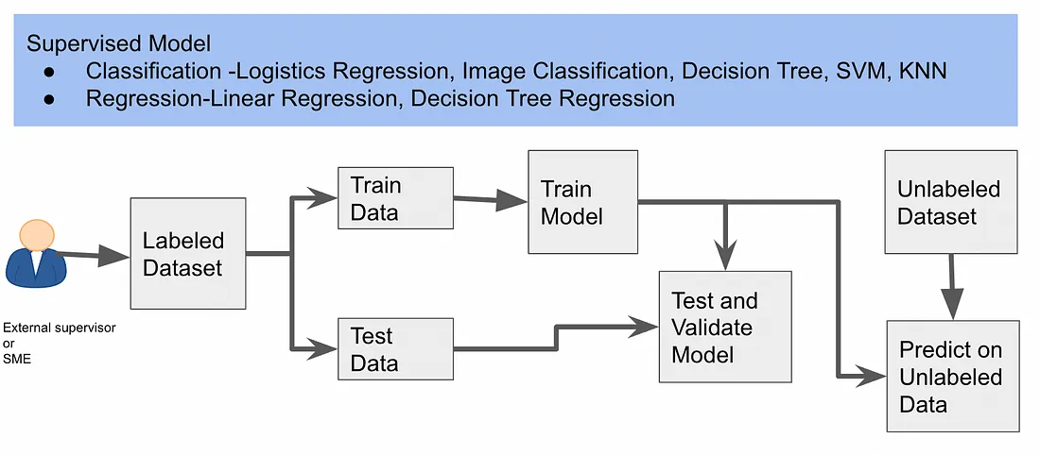

Slide 8
Types of Learning
2. Unsupervised Learning
Supervised learning uses a labeled dataset, typically labeled by an external supervisor, subject matter expert(SME), or an algorithm/program. The dataset is split into training and test dataset for training and then validating the model. The supervised learned model is then used to generate predictions on previously unseen unlabeled data that belongs to the category of data the model was trained on.
Input and output data is provided to a Supervised machine model, so supervised learning is learning by example.

Slide 9
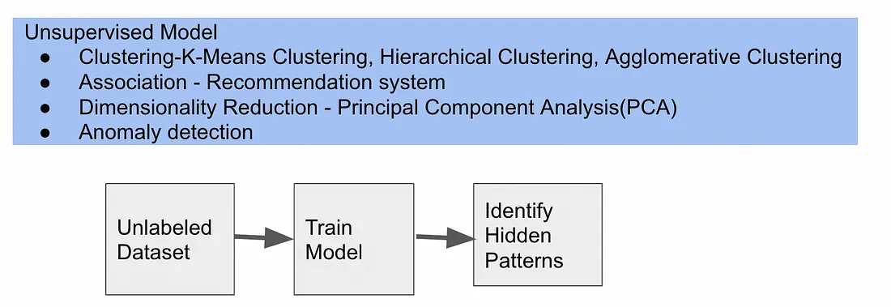

Slide 10
Types of Learning
3. Reinforced Learning
reinforcement learning is a subfield of machine learning in which machines can "live" in an environment and are able to understand the state of that environment as feature vectors. Machines can execute actions in any state. Different actions bring different rewards and can also move the machine to another state of the environment.
The goal of the reinforcement learning algorithm is to learn a policy. Policy is a function f (similar to the model in supervised learning) that takes a state's feature vector as input and output as the optimal action to run in that state. The action will be optimal if it maximizes the expected average reward.

Slide 11
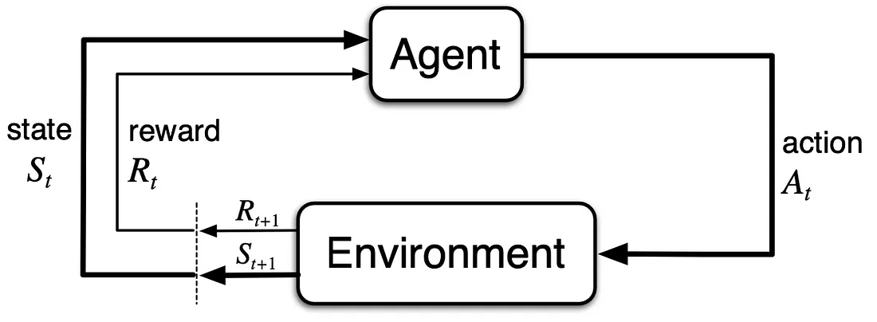
Notes:
Digunakan pada robot, self driving car karena sifatnya continous

Slide 12
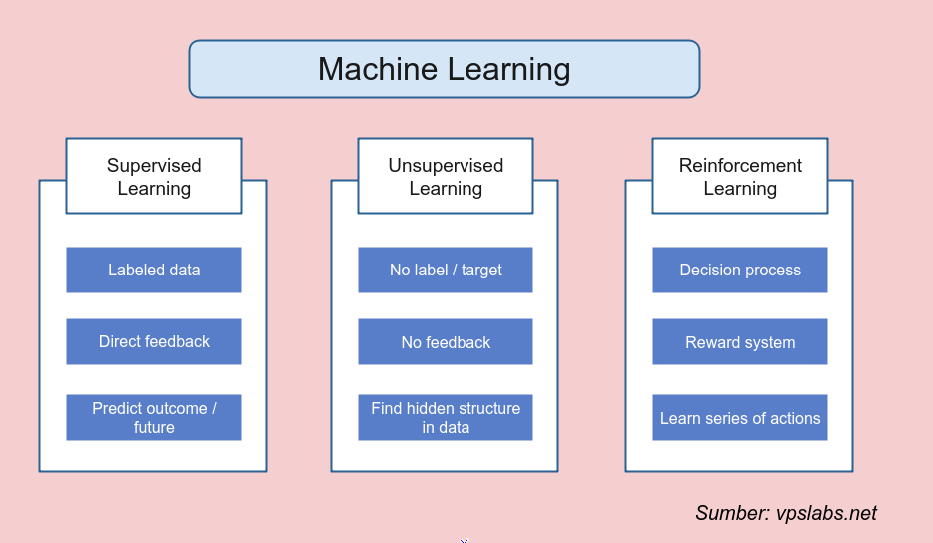

Slide 13

Neural network
Notes:
Setiap neuron memiliki satu inti sel
Informasi melalui axon (output pemrosesan informasi) diterima oleh dendrit
Informasi menjadi masukan bagi neuron lain, masing-masing dendrit tiap neuron dipertemukan oleh synapsis
Informasi akan dijumlahkan dan dikirim oleh axon ke dendrit akhir yang saling bersentuhan
Informasi akan diterima neuron lain jika memenuhi batasan (threshold), maka neuron teraktifasi
Struktur bersifat dinamis (adaptif) dan memiliki kemampuan belajar dengan melakukan adaptasi

Slide 14
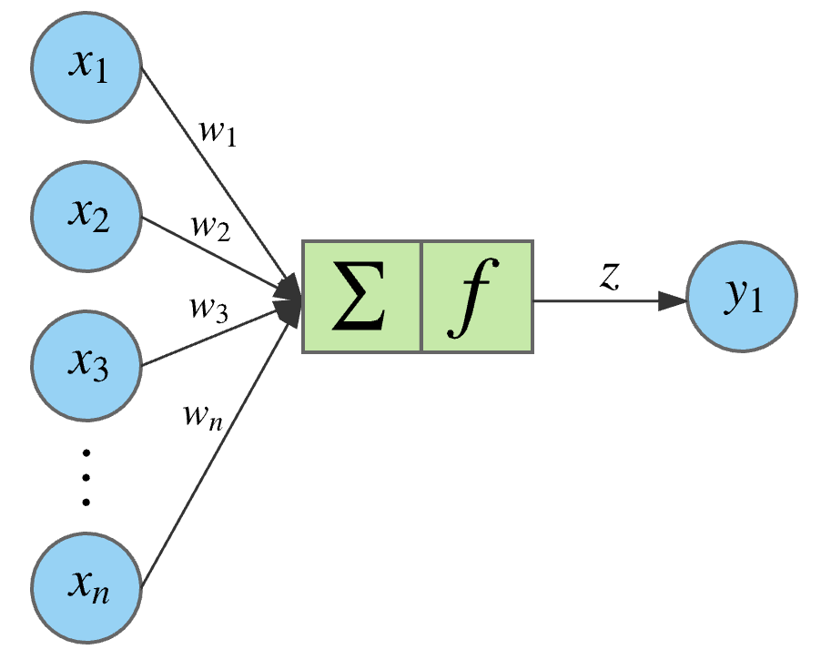
Artificial Neural network

Slide 15
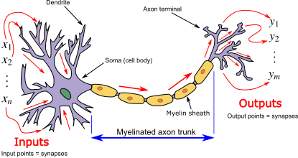
Artificial neural network
Computational models inspired by the human brain:
Algorithms that try to mimic the brain.
Massively parallel, distributed system, made up of simple processing units (neurons)
Synaptic connection strengths among neurons are used to store the acquired knowledge.
Knowledge is acquired by the network from its environment through a learning process
Notes:
Jaringan dari sekelompok unit pemroses kecil yang dimodelkan berdasarkan jaringan syarat manusia
Sistem yang adaptif dapat mengubah strukturnya untuk memecahkan masalah berdasarkan informasi eksternal maupun internal yang mengalir melalui jaringan
Memodelkan hubungan yang kompleks antara input dan output untuk menemukan pola-pola data

Slide 16
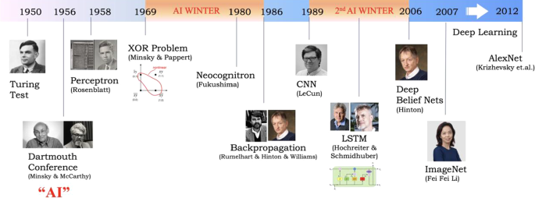
History of ANN
late-1800's - Neural Networks appear as an analogy to biological systems
1960's and 70's – Simple neural networks appear
Fall out of favor because the perceptron is not effective by itself, and there were no good algorithms for multilayer nets
1986 – Backpropagation algorithm appears
Neural Networks have a resurgence in popularity
More computationally expensive

Slide 17
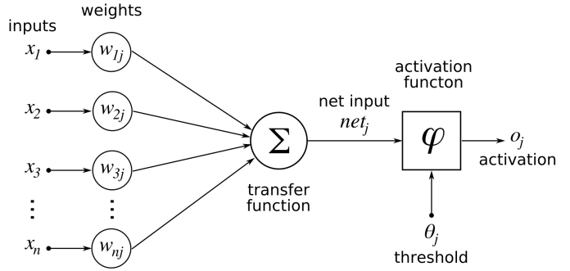
Arsitektur
General architecture

Slide 18
Arsitektur

Slide 19
Learning by trial‐and‐error
Continuous process of:
Trial:
Processing an input to produce an output (In terms of ANN: Compute the output function of a given input)
Evaluate:
Evaluating this output by comparing the actual output with the expected output.
Adjust:
Adjust the weights.

Slide 20
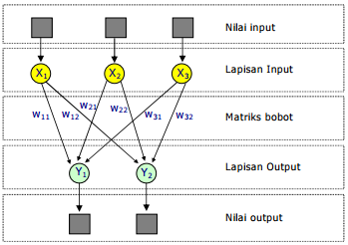
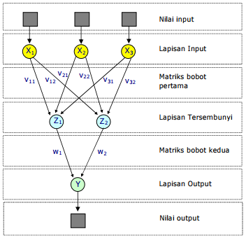
Arsitektur
Single Layer Network
Multi Layer Network
Input layer projecting directly into the output layer.
One or more hidden layers. Input projects only from previous layers onto a layer.

Slide 21
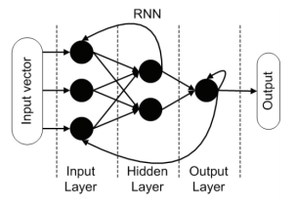
Arsitektur
Recurrent Networks
A network with feedback loop, where some of its inputs are connected to some of its outputs (discrete time).

Slide 22
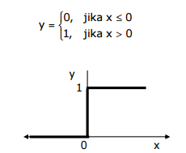
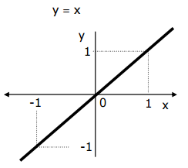
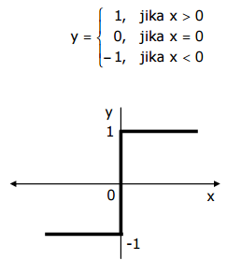
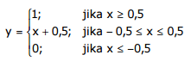
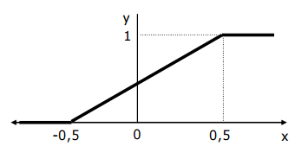
Fungsi Aktivasi
Fungsi Undak Biner (hardlim)
Fungsi linier (purelin)
Fungsi bipolar (hardlims).
Fungsi saturating linear (satlin)

Slide 23
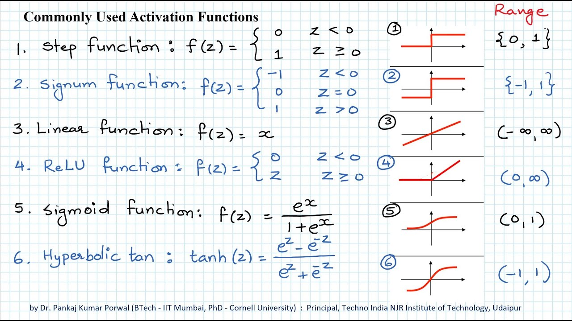
Fungsi Aktivasi

Slide 24
ANN as classifier
Weakness
Long training time
Require a number of parameters typically best determined empirically, e.g., the network topology or “structure.”
Poor interpretability: Difficult to interpret the symbolic meaning behind the learned weights and of “hidden units” in the network

Slide 25
ANN as classifier
Strength
High tolerance to noisy data
Ability to classify untrained patterns
Well-suited for continuous-valued inputs and outputs
Successful on a wide array of real-world data
Algorithms are inherently parallel
Techniques have recently been developed for the extraction of rules from trained neural networks

Slide 26
Recap
Node : Similar to the brain having neurons interlinked to each other, the ANN also has neurons that are linked to each other in various layers of the networks
Weight: Each neuron is linked to the other neurons through connection links that carry weight. The weight has information and data about the input signal. The output depends solely on the weights and input signal.
Target Values: Target values are Correct values of the output variable and are also known as just targets.
Learning Rate: The learning rate is denoted α. It ranges from 0 to 1. It is used for balancing weights during the learning of ANN.

Slide 27
Recap
Bias: Bias is a constant that is added to the product of inputs and weights to calculate the product. It is used to shift the result to the positive or negative side.
Threshold: A threshold value is a constant value that is compared to the net input to get the output. The activation function is defined based on the threshold value to calculate the output.
Activation Function: These are ordinary non-linear functions used in Deep Learning that have the sole purpose of receiving input and making it non-linear.
Epoch : Each time we train our model with every data example we have, we complete an “epoch”.

Slide 28
Perceptron Feedforward

Slide 29
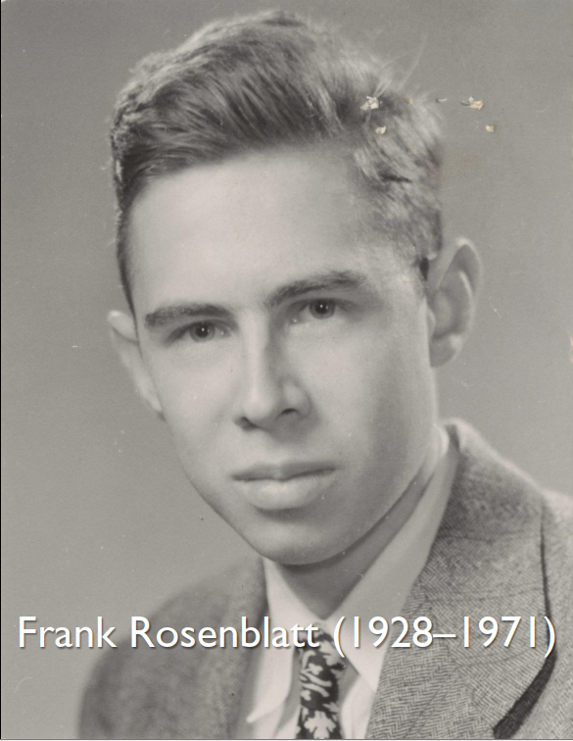
perceptron
In 1958, Frank Rosenblatt created a computational model of a neuron: the perceptron, which is the basis for most of what came afterward.
The perceptron receives an “x” vector, has a set of weights “w”, and computes the dot product of “x” with “w” (the weighted sum) and feeds it to “a”, the activation function. Formally, P(x; w) = a(x ⋅ w).
Implemented on IBM 704 as later called Mark I Perceptron and claimed to better than Hebb rule algorithm

Slide 30
perceptron
Proses pelatihan iteratif (beberapa epoch)
Menggunakan parameter learning rate 𝛼 untuk mengatur laju pelatihan
Parameter 𝛼 digunakan pada saat mengubah nilai bobot: 𝑤𝑖′ = 𝑤𝑖 + 𝛼𝑡𝑥𝑖
Pada proses pelatihan, dihitung nilai error antara nilai output dan nilai target
Update bobot dan bias.
Jika tidak ada error, maka nilai bobot tidak diubah

Slide 31
Algoritma Perceptron
Inisialisasi:
bobot (random)
bias (random)
learning rate 𝛼 (0 < 𝛼 ≤ 1)
max epoch
2. Selama kondisi berhenti belum tercapai, lakukan langkah 3–8
3. Untuk setiap data latih 𝑠 dan target 𝑡, lakukan langkah 4–7

Slide 32
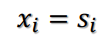
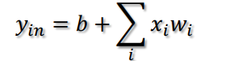
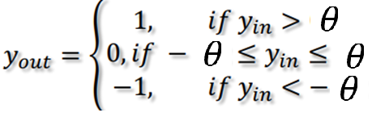
Algoritma Perceptron
4. Set nilai setiap neuron input dengan data latih x_{i}.
5. Hitung fungsi output y_{in} :
6. Hitung nilai fungsi aktivasi y_{out}
*fungsi aktivasi bebas

Slide 33
Algoritma Perceptron
7. Lakukan komparasi
Jika 𝑦_{out} = 𝑡arget (t):
𝑤𝑖′ = 𝑤𝑖
𝑏′ = 𝑏a
Jika tidak, update bobot:
𝑤𝑖′ = 𝑤𝑖 + ∆𝑤
𝑤𝑖′ = 𝑤𝑖 + 𝛼𝑡𝑥
𝑏′ = 𝑏 + ∆ 𝑏
𝑏′ = 𝑏 + 𝛼𝑡
8. Berhenti jika
Max epoch terpenuhi
Tidak ada perubahan error
Mencapai batas threshold error / konvergen

Slide 34
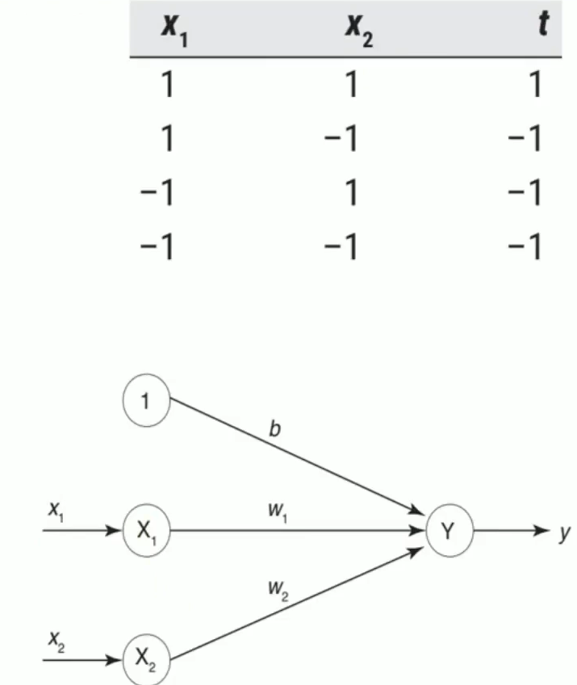
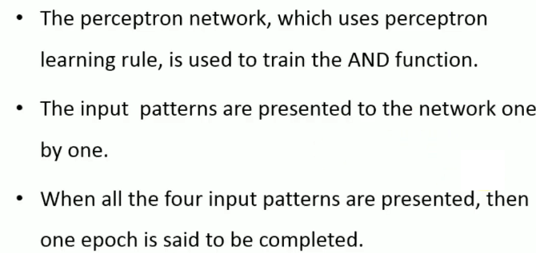
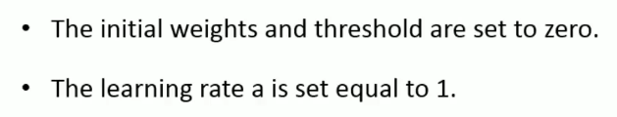
Contoh perceptron : AND
AND FUNCTION

Slide 35
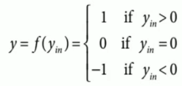
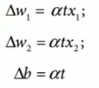
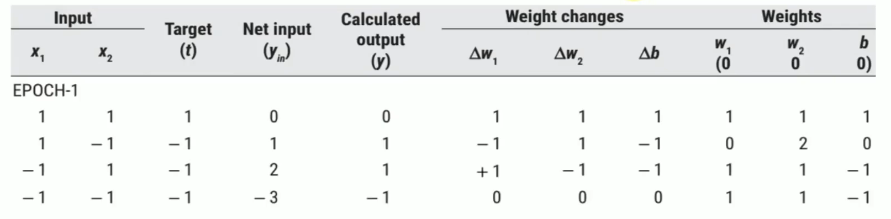
Contoh Perceptron : AND
Fungsi aktivasi bipolar (hardlims)
Delta bobot

Slide 36
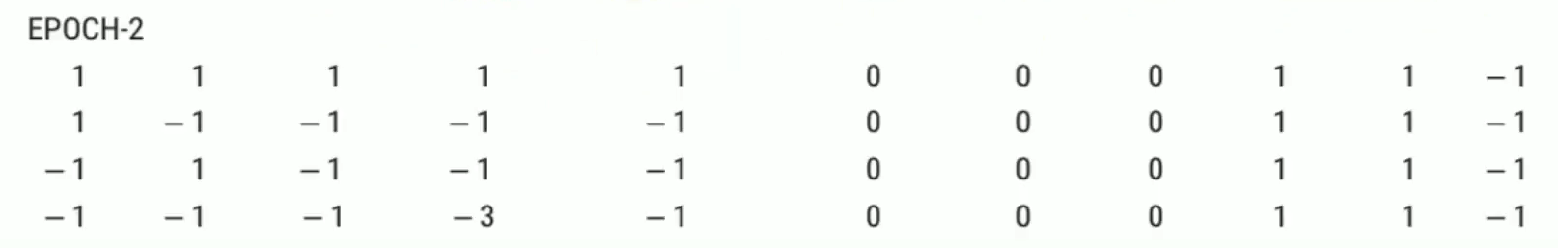
Contoh Perceptron : AND
Fungsi aktivasi bipolar (hardlims)
Delta bobot

Slide 37
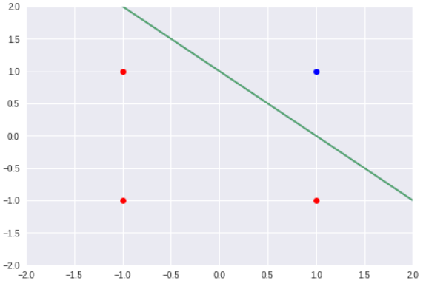
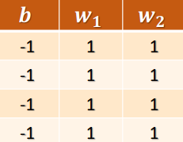
Contoh Perceptron : AND

Slide 38
Back propagation

Slide 39
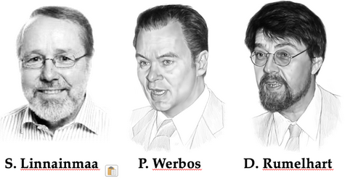
Backpropagation
Backpropagation was orginally created in the early 1960s and implemented on computers during1970 by Seppo Linnainmaa, Paul Werbos and Rumelhart.
It Iteratively processes a set of training tuples & compare the network's prediction with the actual known target value
For each training tuple, the weights are modified to minimize the mean squared error between the network's prediction and the actual target value
Modifications are made in the “backwards” direction: from the output layer, through each hidden layer down to the first hidden layer, hence “backpropagation”

Slide 40
Backpropagation
Proses pelatihan iteratif (beberapa epoch)
Menggunakan parameter learning rate 𝛼 untuk mengatur laju pelatihan
Menggunakan minimal sebuah hidden layer (multilayer).
Pada proses pelatihan, dimulai dengan feedforward untuk mendapatkan nilai output.
Delta nilai koreksi error antara nilai output dan nilai target diperoleh melalui proses backpropagasi
Update bobot dan bias
Berhenti jika sudah memenuhi terminating condition

Slide 41
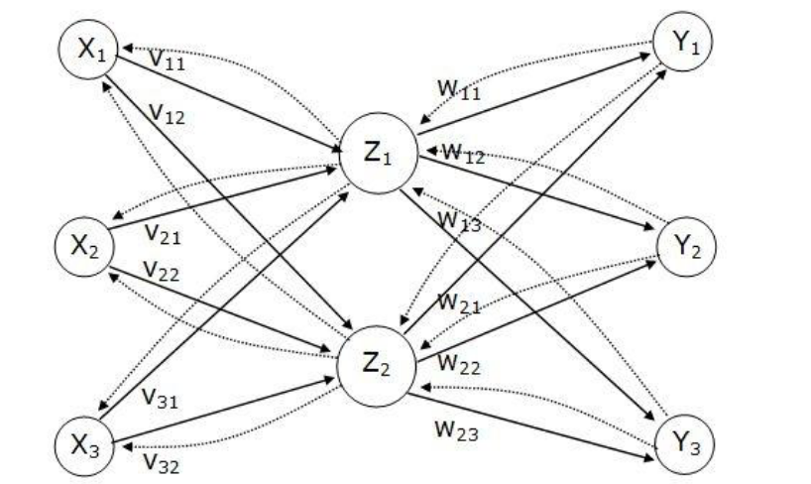
Backpropagation

Slide 42
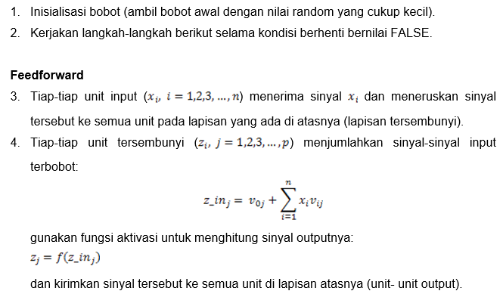
Algoritma Backpropagation
Algoritma backpropagation:

Slide 43
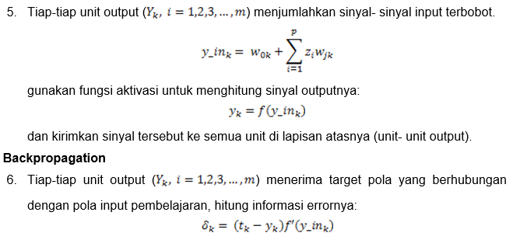
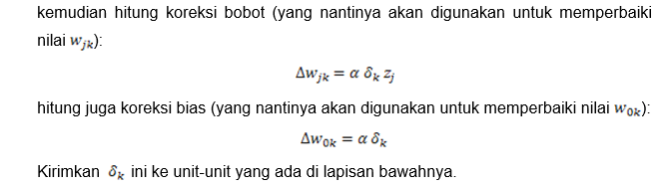
Algoritma Backpropagation

Slide 44
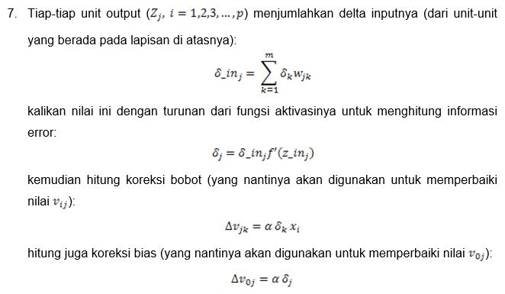
Algoritma Backpropagation

Slide 45
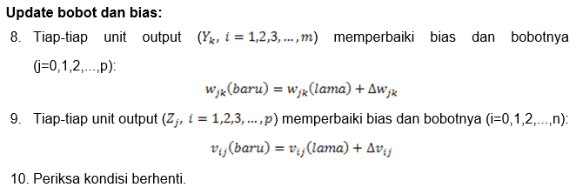
Algoritma Backpropagation

Slide 46
Contoh Backpropagation : XOR
Akan dibentuk jaringan syaraf untuk operasi XOR.
Ada 2 input (X1 dan X2) dengan 1 output (target T).
Arsitektur jaringan terdiri-dari:
1 lapisan input,
1 lapisan tersembunyi dengan 4 neuron, fungsi aktivasi yang digunakan pada setiap neuron pada lapisan ini adalah fungsi sigmoid biner(logsig)
1 lapisan output dengan 1 neuron, fungsi aktivasi yang digunakan pada neuron di lapisan ini adalah fungsi sigmoid biner(logsig).
Bobot awal yang menghubungkan neuron-neuron pada lapisan input dan lapisan tersembunyi (v11,v12,v21,v22) dan bobot bias v01 dan v02 dipilih secara acak. Demikian pula bobot awal yang menghubungkan neuron-neuron pada lapisan tersembunyi dan lapisan output (w1, w2 ) dan bobot bias w0 juga dipilih secara acak.

Slide 47
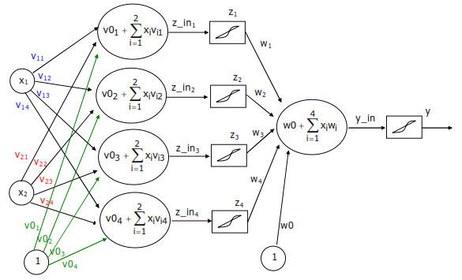
Contoh Backpropagation : XOR

Slide 48
Contoh Backpropagation : XOR
X1 | X2 | T
0 | 0 | 0
0 | 1 | 1
1 | 0 | 1
1 | 1 | 0
Jumlah neuron pada input layer = 4
Jumlah neuron pada hidden layer = 2
Jumlah neuron pada output layer = 1
Learning rate (α) = 0,02
Maksimum Epoh = 500
Target Error = 0,01

Slide 49
Contoh Backpropagation : XOR
Bobot awal (ditentukan secara acak):
Bobot Awal input ke hidden
v =
0,9562 0,7762 0,1623 0,2886
0,1962 0,6133 0,0311 0,9711
Bobot Awal bias ke hidden
v0 =
0,7496 0,3796 0,7256 0,1628
Bobot Awal hidden ke output
w =
0,2280
0,9585
0,6799
0,0550
Bobot Awal bias ke output
w0 =
0,9505

Slide 50
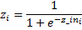
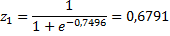
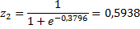
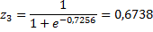
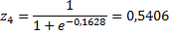
Contoh Backpropagation : XOR
Feedforward
Data ke = 1
--------------------------------
Operasi pada Hidden Layer
> Penjumlahan terbobot:
z_in₁ = v0₁ + v₁₁*x₁₁ + v₂₁*x₁₂
= 0,7496 + 0,9562*0 + 0,1962*0
= 0,7496
z_in₂ = v0₂ + v₁₂*x₁₁ + v₂₂*x₁₂
= 0,3796 + 0,7762*0 + 0,6133*0
= 0,3796
z_in₃ = v0₃ + v₁₃*x₁₁ + v₂₃*x
= 0,7256 + 0,1623*0 + 0,0311*0
= 0,7256
z_in₄ = v0₄ + v₁₄*x₁₁ + v₂₄*x₁₂
= 0,1628 + 0,2886*0 + 0,9711*0
= 0,1628
Aktivasi

Slide 51
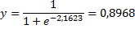
Contoh Backpropagation : XOR
Feedforward
Data ke = 1
--------------------------------
Operasi pada Output Layer --->
> Perkalian:
y_in = w0 + w₁*z₁ + w₂*z₂ + w₃*z₃ + w₄*z₄
= 0,9505 + 0,2280*0,6791 + 0,9585*0,5938 + 0,6799*0,6738 + 0,0550*0,5406
= 2,1623
Aktivasi
Error = 0 – 0,8968 = -0,8968
MSE = (-0,8968)² = 0,80428

Slide 52
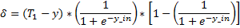
Contoh Backpropagation : XOR
Backpropagation
Informasi error output
Selisih error bobot hidden layer
Selisih error bias hidden layer

Slide 53
Contoh Backpropagation : XOR
Backpropagation
Koreksi bobot hidden layer
Koreksi bias hidden layer

Slide 54
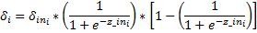
Contoh Backpropagation : XOR
Backpropagation
Delta input
Informasi error input

Slide 55
Contoh Backpropagation : XOR
Backpropagation
Selisih error bobot input layer
Selisih error bias input layer

Slide 56
Contoh Backpropagation : XOR
Backpropagation
Koreksi bobot input layer
Koreksi bias input layer

Slide 57
Contoh Backpropagation : XOR
Backpropagation
Lanjut data 2, 3 dan 4...
Selesai 1 epoch
Ulangi pemrosesan data 1,2,3,4…
Selesai 2 epcoh.
…
…
…
…
…
Selesai jika epoch max / konvergen

Slide 58
Thank You
Verdysgn
Notes:
https://red-colmena.com/f/JyY1ajY1JmhhZSFpdC91JGcmIyEsYGU/18/08/cw_5g_training_v3_slides.pdf
https://www.youtube.com/watch?v=vF2fV_gJ81g

